Slide 1
Software Engineering

Slide 2
Requirements ---- Introduction
Requirements form the basis for all software products
“Something required, something wanted or needed”
– Webster’s dictionary
Note: There is a huge difference between wanted and needed and it should be kept in mind all the time

Slide 3
Requirements ---- Introduction
A complete description of what the software system will do without describing how it will do it is represented by the software requirements
The hardest single part of building a software system is deciding what to build...No other part of the work so cripples the resulting system if done wrong. – Fred Brooks

Slide 4
Requirements ---- Introduction
“A condition or capability needed by a user to solve a problem or achieve an objective” – IEEE
Software requirements are complete specification of the desired external behavior of the software system to be built
They also represent External behavior of the system

Slide 5
Requirement Engineering
Requirements engineering is the process, which enables us to systematically determine the requirements for a software product

Slide 6
A Systems Approach towards Scoping
Hardware/Software
People
Interactions

Slide 7
A Systems Approach (Contd.)
Objects
i.e. things
Activities
Actions taken
Input / Outputs
Relationships for example:
Which object performs what activities
Which objects are associated with other objects
System Boundary
Who generates input and who receives output
Which objects/activities are part of the system and which are not
Nested systems, related systems, interrelated systems

Slide 8
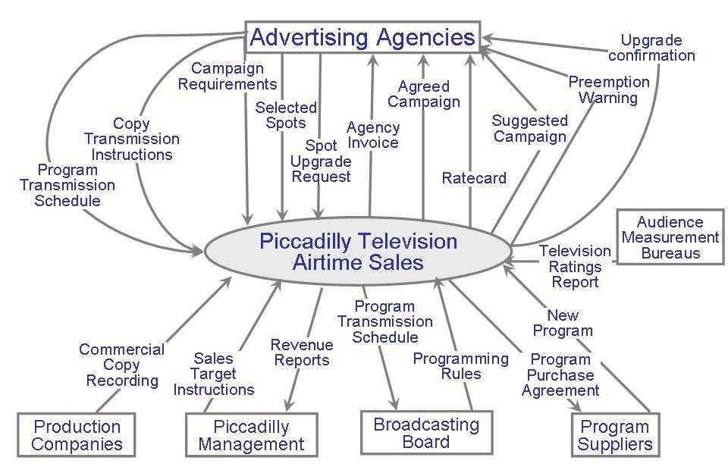
Requirements Engineering
Seven tasks:
Inception
Elicitation
Elaboration
Negotiation
Specification
Validation
Management
(understand problem, people, nature of solution, effectiveness of communication).
Ask questions about objectives, targets, detailed requirements etc.
Identify software function, behavior, information. Develop Requirements Model!!! Analysis???
Resolve conflicts. Prioritize Requirements!!!
Write document containing requirements models, scenarios etc.
Ensure that all requirements have been stated, unambiguously!
Identify, control, track requirements and changes

Slide 9
Inception
We need a time series model for the purpose of forecasting demand
Identify: all stakeholders, measurable benefits of successful implementation, possible alternatives
Ask questions stepwise, as early as possible, first meeting/encounter
Possible questions at 1st step (stakeholders, overall goals and benefits):
Who is behind the request for this work?
Who will use this solution?
What will be the economic benefit of a successful solution?
Goods Retailer with physical shops;
Food retailer
E-commerce retailer
Wholesaler (any)

Slide 10
Inception
Possible questions at 2nd step (detailed understanding and customer perception about the solution):
What problems(s) will this solution address?
Can you show me (or describe) the business environment in which the solution will be used?
How do you characterize the ‘good’ output?
Possible questions at 3rd step (effectiveness of communication):
Are you the right person to answer these questions?
Are my questions relevant to the problem that you have?
Can anyone else provide additional information?

Slide 11
Requirements Elicitation
Get more detailed requirements
Customers do not always understand what their needs and problems are
It is important to discuss the requirements with everyone who has a stake in the system
Come up with agreement on what the requirements are
If we cannot agree on what the requirements are, then the project is doomed to fail

Slide 12
Requirements Elicitation
Different Stakeholders are:
Clients: pay for the software to be developed
Customers: buy the software after it is developed
Users: use the system
Domain experts: familiar with the problem that the software must automate
Market Researchers: conduct surveys to determine future trends and potential customers
Lawyers or auditors: familiar with government, safety, or legal requirements
Software engineers or other technology experts

Slide 13
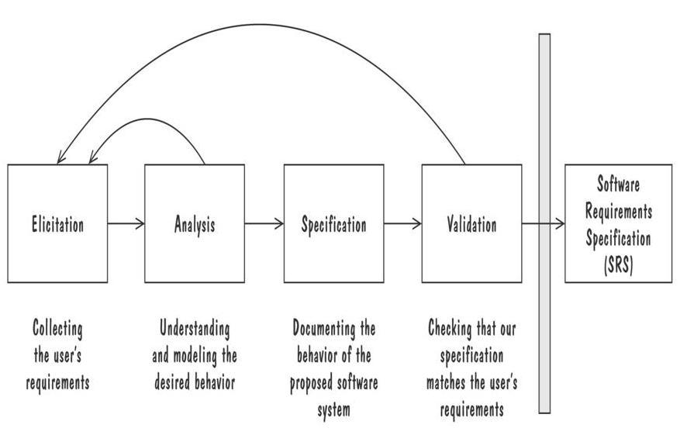
Requirements Elicitation
Involves elements from elaboration, negotiation, specification, problem solving
Process for Capturing Requirements

Slide 14
Elaboration
Analyze, model, specify…
Some Analysis Techniques
Data Flow Diagrams (DFD)
Usecase Diagram
Object Models (ER Diagrams, Abstract class diagrams)
Decision Tables
State Diagrams (Statecharts)
Fence Diagrams
Event Tables
Petri Nets
Event Traces (Message Sequence Charts)
Flow-oriented, Scenario-based, Class-based, Behavioral

Slide 15
Examples of Requirement
The system shall maintain records of all payments made to employees on accounts of salaries, bonuses, travel/daily allowances, medical allowances, etc.
The system shall allow users to search for an item by title, author, or by International Standard Book Number
The system’s user interface shall be implemented using a web browser
The system shall support at least twenty transactions per second
The system facilities which are available to public users shall be demonstrable in ten minutes or less

Slide 16
Types of Requirements
Functional requirement
Describes: interaction between the system and its environment, how should the system behave given certain stimuli, required behaviour in terms of required activities
Example: For a system of printing pay cheques the functional requirements must answer the following:
When are pay cheques issued?
What input is necessary for a pay cheque to be printed?
Quality requirement or non-functional requirement
Describes: some quality characteristic that the software must posses, a restriction on the system that limits our choices for constructing a solution
Constraints could be:
Design constraint: a design decision such as choice of platform or interface components
Process constraint: a restriction on the techniques or resources that can be used to build the system
Example: queries to the system must be answered within 3 seconds

Slide 17
Functional Requirement
Statements of services the system should provide
– Reaction to particular inputs
– Behavior in particular situations
Statements describing what the system does
Functionality of the system
Functional requirements should be complete and consistent

Slide 18
Examples of Functional Requirement
The user shall be able to search either the entire database of patients or select a subset from it (admitted patients, or patients with asthma, etc.)
The system shall allow customers to return non-perishable items within fifteen days of the purchase. A customer must present the original sale receipt to return an item
The system shall maintain records of all payments made to employees on accounts of salaries, bonuses, travel/daily allowances, medical allowances, etc.

Slide 19
Examples of Functional Requirement
The system shall interface with the central computer to send daily sales and inventory data from every retail store
The system shall maintain records of all library materials including books, serials, newspapers and magazines, video and audio tapes, reports, collections of transparencies, CD- ROMs, DVDs, etc.
The system shall allow users to search for an item by title, author, or by International Standard Book Number

Slide 20
Non-Functional Requirements
Non-functional requirements define the quality attribute of a software system.
Constraints on the services or functions offered by the system such as timing constraints, constraints on the development process, standards, etc
They represent a set of standards used to judge the specific operation of a system. Example, how fast does the website load?
A non-functional requirement is essential to ensure the usability and effectiveness of the entire software system.
Failing to meet non-functional requirements can result in systems that fail to satisfy user needs (in terms of quality).

Slide 21
Non-Functional Requirements - Examples
Non functional requirements are security, safety, availability, testability, performance, usability etc. For example
System should support 2 million users at a time
The ATM should be available 24/7
The system should be easy to upgrade
The data of system should be secured
The system should be implemented using Java
The user interface should be combination of pictures and text. The color of text should be grey

Slide 22
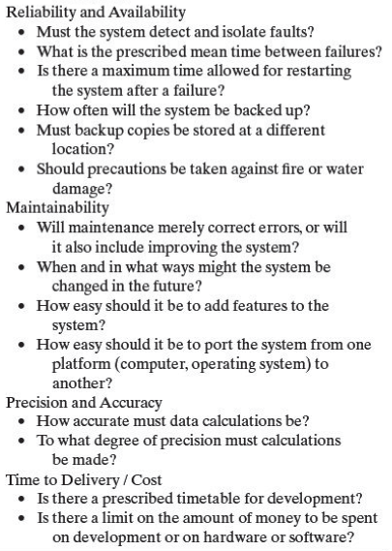
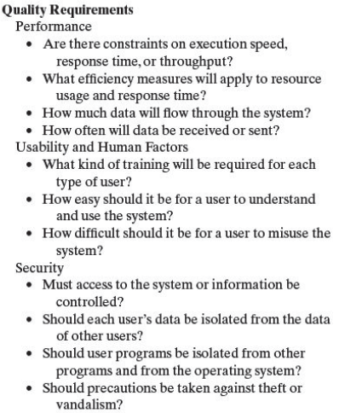
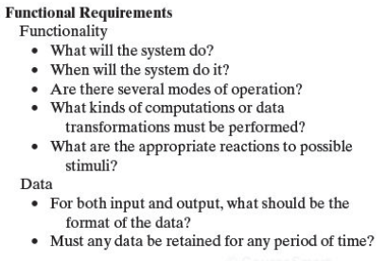

Slide 23
Characteristics of Requirements
Correct
Consistent
Unambiguous
Complete
Feasible
Relevant
Testable
Traceable

Slide 24
Ambiguous Requirements
Requirements should be unambiguous and consistent
Incomplete and ambiguous requirements are open to multiple interpretations and assumptions
This can lead to the development of poor quality, or faulty, software product

Slide 25
Functional Requirement #1
The system shall solve a quadratic equation using the following formula
x = (-b+sqrt(b²– 4*a*c))/2*a
Notice the ambiguity in the requirement for solving the quadratic equation. The requirement does not speak about the possibility when the value of ‘a’ is zero

Slide 26
Functional Requirement #2
The system shall provide appropriate viewers for the user to read documents in the document store
Notice the ambiguity in the requirement, which uses the term ‘appropriate viewers’
This requirement does not mention the formats of documents and types of viewers, which can be used

Slide 27
Functional Requirement #3
Every order shall be allocated a unique identifier (ORDER_ID) which the user shall use to access that order
Notice the ambiguity in the requirement, what should be format of unique identifier

Slide 28
Testable and Non-Testable Requirements
Testable : A requirement which is unambiguous and clearly specifies the behavior.
Non-Testable: A requirement which is very interpretive and do not specify exact behavior of the software .

Slide 29
Testable Requirements
Testable/Measurable Requirement:
Objective description of the requirement’s meanings
All possible entities and activities can be examined and classified as Meet Requirements and Do Not Meet Requirements
Testable requirements are helpful in making good design
Requirements that are not testable are likely to be ambiguous, incomplete and incorrect

Slide 30
Testable Requirements
Robertson and Robertson suggest 3 ways to help make requirements testable:
Specify a quantitative description for each adverb and adjective
Replace pronouns with specific names of entities
Make sure that every noun is defined in exactly one place in the requirements document

Slide 31
Testable Requirements
Some examples:
Not Testable: Water quality information must be accessible immediately
Testable: Water quality information must be retrieved within five seconds of request
Not Testable: The system should handle a large number of users at a time
Testable: The system should handle 5000 users at a time
Not Testable: User should press the Save button when writing text in the system. This prevents it from being lost.
Testable: User should press the Save button when writing a note in the system. Pressing the Save button prevents the text from being lost.

Slide 32
Examples of Testable and Non Testable Requirement
All Users are allowed to post Only 5 Questions per day in this Forum
Testable as it Clearly specifies the Limit allowed
Users Reply to a question is made visible to all board members as soon as possible
Non-Testable as it does not state Where/How it will be made visible and does not specify a "value" instead of "as soon as possible".
The user interface must look modern and attractive. The application must be fast. The user interface must be very responsive.
These requirements are non testable as there is no measure to test modern and attractive, and what is meant by “very responsive”

Slide 33
Requirements Elicitation
“Requirements elicitation corresponds to the search for information about the functions that the system must perform, and for the constraints under which the system must operate.”
Requirements elicitation is the practice of researching and discovering the requirements of a system from users, customers, and other stakeholders
To Acquire or elicit information from users
It is requirement gathering process

Slide 34

Requirement Elicitation Process
Requirements gathering - The developers discuss with the client and end users and know their expectations from the software.
Organizing Requirements - The developers prioritize and arrange the requirements in order of importance, urgency and convenience.

Slide 35
Requirement Elicitation Process
Negotiation & discussion - If requirements are ambiguous or there are some conflicts in requirements of various stakeholders, if they are, it is then negotiated and discussed with stakeholders. Requirements may then be prioritized and reasonably compromised.
The requirements come from various stakeholders. To remove the ambiguity and conflicts, they are discussed for clarity and correctness. Unrealistic requirements are compromised reasonably.
Documentation - All formal & informal, functional and non-functional requirements are documented and made available for next phase processing.

Slide 36
Requirements Elicitation Techniques
Stakeholder analysis
Analysis of existing systems
Review available documentation or background reading
Observation and Social Analysis
Brainstorming
Survey/Questionnaires
Interviewing
Prototyping

Slide 37
Requirements Documentation Requirement Definition: Steps Documenting Process
Outline the general purpose and scope of the system, including relevant benefits, objectives, and goals
Describe the background and the rationale behind proposal for new system
Describe the essential characteristics of an acceptable solution
Describe the environment in which the system will operate
Outline a description of the proposal, if the customer has a proposal for solving the problem
List any assumptions we make about how the environment behaves

Slide 38
Requirements Documentation Requirement Specification: Steps Documenting Process
Describe all inputs and outputs in detail, including
the sources of inputs
the destinations of outputs,
the value ranges
data format of inputs and output data
data protocols
window formats and organizations
timing constraint
Restate the required functionality in terms of the interfaces' inputs and outputs
Devise fit criteria for each of the customer's quality requirements

Slide 39
Requirements Documentation IEEE Standard for SRS Organized by Requirements
Introduction to the Document
1.1 Purpose of the Product
1.2 Scope of the Product
1.3 Acronyms, Abbreviations, Definitions
1.4 References
1.5 Outline of the rest of the SRS
General Description of Product
2.1 Context of Product
2.2 Product Functions
2.3 User Characteristics
2.4 Constraints
2.5 Assumptions and Dependencies
Specific Requirements
3.1 External Interface Requirements
3.1.1 User Interfaces
3.1.2 Hardware Interfaces
3.1.3 Software Interfaces
3.1.4 Communications Interfaces
3.2 Functional Requirements
3.2.1 Requirement 1
3.2.2 Requirement 2
…
3.3 Performance Requirements
3.4 Design Constraints
3.5 Other Quality Requirements
3.6 Other Requirements
Appendices
Functional Requirements for a Spellchecker:
Requirement 1:
System should keep track of words being typed in the existing word processor
Requirement 2:
System should check against each typed word if it is a valid word in the corresponding dictionary
Requirement 3:
System should highlight the wrong words (i.e. which are not part of dictionary) while the user types in the existing word processor.
Requirement 4:
System should give the user an option to make correction in case there is a wrong word typed
Requirement 5:
System should suggest correct words when user opts to make a correction against a wrong word
Non Functional Requirements for a Spellchecker:
Requirement 1:
System should integrate with an existing word processor that runs on Linux.
Requirement 2:
System should use Red color to highlight the wrong words

Slide 40
Requirements Documentation Process Management and Requirements Traceability
Process management is a set of procedures that track
the requirements that define what the system should do
the design modules that are generated from the requirement
the program code that implements the design
the tests that verify the functionality of the system
the documents that describe the system
It provides the threads that tie the system parts together

Slide 41
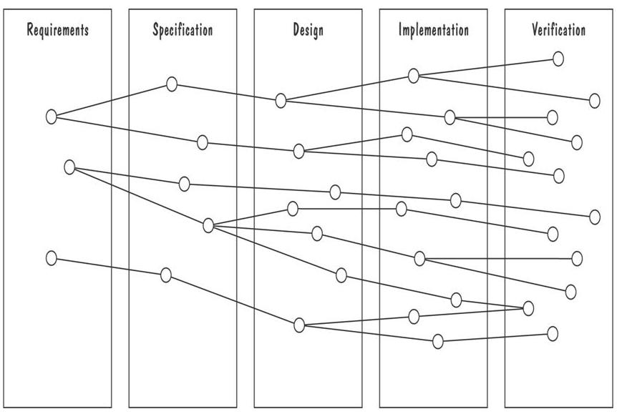
Requirements Documentation Development Activities and Traceability
Horizontal threads show the coordination between development activities

Slide 42
Validation and Verification
In requirements validation, we check that our requirements definition accurately reflects the customer's needs
In verification, we check that one document or artefact conforms to another
Verification ensures that we build the system right, whereas validation ensures that we build the right system

Slide 43
Validation and Verification Requirements Review
Review the stated goals and objectives of the system
Compare the requirements with the goals and objectives
Review the environment in which the system is to operate
Review the information flow and proposed functions
Assess and document the risk, discuss and compare alternatives
Testing the system: how the requirements will be revalidated as the requirements grow and change

Slide 44
Validation and Verification Verification
Check that the requirements-specification document corresponds to the requirements-definition
Make sure that if we implement a system that meets the specification, then the system will satisfy the customer's requirements
Ensure that each requirement in the definition document is traceable to the specification

Slide 45
Measuring Requirements
Measurements focus on three areas
product
process
resources
Number of requirements can give us a sense of the size of the developed system
Number of changes to requirements
Many changes indicate some instability or uncertainty in our understanding of the system
Requirement-size and change measurements should be recorded by requirements type

Slide 46
Elaboration
Analyze, model, specify…
Some Analysis Techniques
Data Flow Diagrams (DFD)
Usecase Diagram
Object Models (ER Diagrams, Abstract class diagrams)
Decision Tables
State Diagrams (Statecharts)
Fence Diagrams
Event Tables
Petri Nets
Event Traces (Message Sequence Charts)
Flow-oriented, Scenario-based, Class-based, Behavioral

Slide 47
Use Case Diagram
Components
A large box: system boundary
Stick figures outside the box: actors, both human and systems
Each oval inside the box: a use case that represents some major required functionality and its variant
A line between an actor and use case: the actor participates in the use case
Use cases do not necessarily model all the tasks, instead they are used to specify user views of essential system behavior

Slide 48
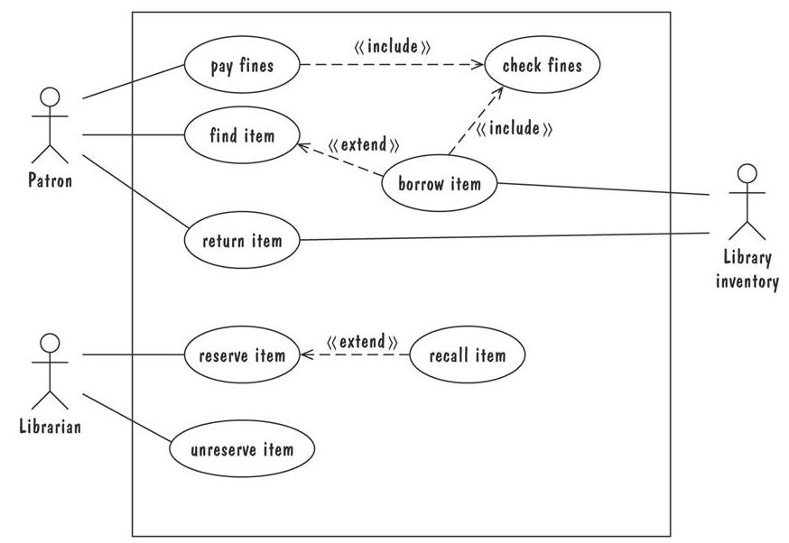
Use Case Diagram
Library use cases including borrowing a book, returning a borrowed book, and paying a library fine

